Slide 1
Case Study 2
Twitter Beijing 2022
By: Enbo Tian, Sirshendu Ganguly, Dang Tran

Slide 2
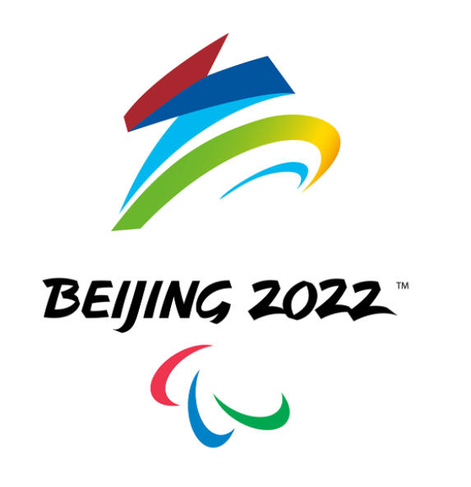

Motivation and Background
Held form Feb 4th to Feb 20th
Opening Ceremony
Closing Ceremony
Slogan: Together for a shared Future
Motto: Faster, Higher, Stronger, Together
Mascot: Bing Dwen Dwen

Slide 3
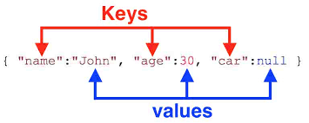
Data Source
Data was gotten from Twitter Search API
Data Characteristics
The data was unstructured data, as it was in JSON format
Consisted of text and numbers
There was also some nominal categorical data, for example, “follow_request_sent”
There were also some missing data

Slide 4
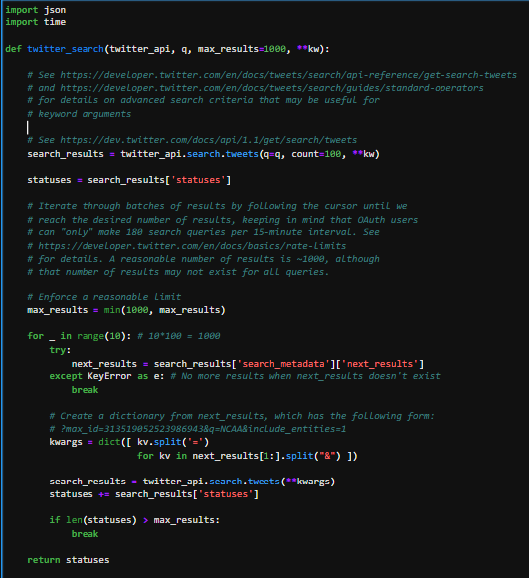
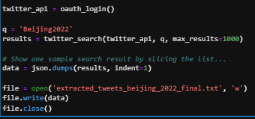
Methodology - Data Collection
Chose “Beijing2022” as our keyword
Used the Twitter Search API to collect a sample of tweets in JSON format

Slide 5
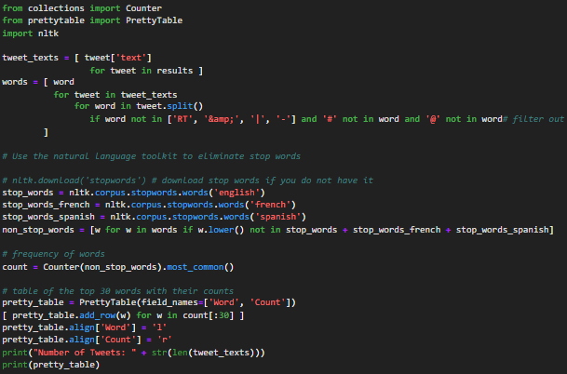
Methodology - Word Count
Used ntlk library to get rid of stop words.
Counter used to find the most frequently used words.
PrettyTable formatted the data into a table of the top 10 words.
Notes:
For our word count analysis, first we used the nltk library to get rid of all the common stop words in our collection of tweets. Counter was used to easily find the most frequently used words and PrettyTable put them together in a table of the top 30 words with the highest counts.

Slide 6
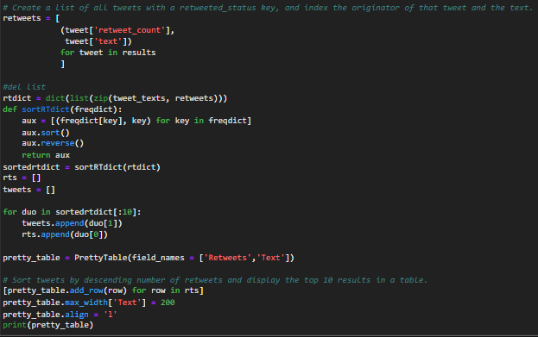
Methodology - Popular Tweets
Used retweet counts to determine popularity.
Put tweets and retweet counts together into a dictionary of tuples for sorting.
PrettyTable formatted the data into a table.
Notes:
To get the most popular tweets, we decided to determine their popularity by the retweet counts. First we put the tweets and their retweet counts together into a dictionary of tuples. Then we simply created a function to sort the dictionary by the retweet counts and put them together into a table of the top 10 most popular tweets using PrettyTable.

Slide 7
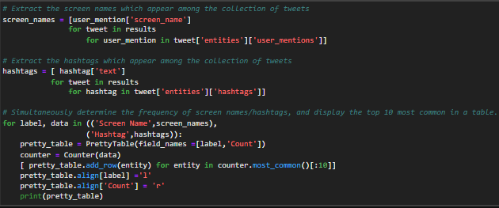
Methodology - Popular Hashtags and User Mentions
Same methodology for word counts.
Counter used to find the most common hashtags and user mentions.
PrettyTable formatted the data into a table of the top 10 hashtags and user mentions.
Notes:
To find the most popular hashtags and user mentions we employed a simpler methodology from that of our word count analysis. We used Counter to find the most frequently used hashtags and user mentions from our tweet collection then used PrettyTable to put them into tables of the top 10 most popular hashtags and user mentions.

Slide 8
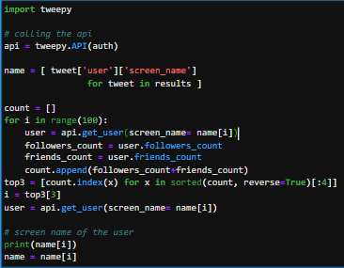
Methodology - User Selection
Went through the first 100 users.
Employed tweepy to access the users’ friends and followers counts.
Chose the 3rd most popular user based on the sum of their follower and friend counts.
3rd most popular because the 1st and 2nd most popular users tend to have a higher ratio between follower and friend which resulted in less mutuals.
Notes:
To choose the user, we went through the first 100 users in our data and chose the 3rd most popular user based on the sum of their follower and friend count. We chose the 3rd one because the most popular users tend to have a much higher ratio between follower and friend count which resulted in less chances of there being mutuals between the 2.

Slide 9
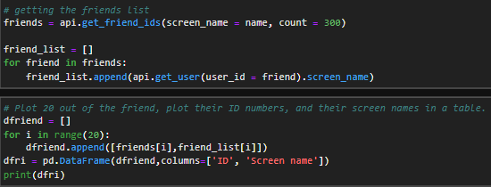
Methodology - User Friends
Collected 300 of the user’s friends IDs. (rate limit)
Used tweepy methods to collect screen names using users’ IDs.
Plot out a table of 20 of the friends’ IDs and screen names with panda dataFrame
Notes:
Using twitter api, we gathered 300 user ids of the chosen user’s friends.
We decided on 300 due to their being a rate limit of 900 every 15 minutes.
300 allows us to troubleshoot quicker and runs the data collection for both friend and follower in quick succession.
We then used twitter api again to collect the screen names of the users based on their ID.
Finally, we used panda dataFrame to put our data together and create a table of 20 of the designated user’s IDs and screen names.

Slide 10
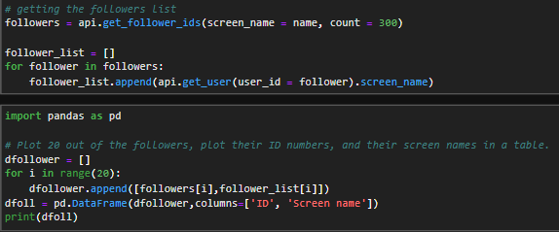
Methodology - User Followers
Collected 300 of the user’s followers IDs. (rate limit)
Used tweepy methods to collect screen names using users’ IDs.
Plot out a table of 20 of the followers’ IDs and screen names with panda dataFrame
Notes:
Using twitter api, we gathered 300 user ids of the chosen user’s friends.
We decided on 300 due to their being a rate limit of 900 every 15 minutes.
300 allows us to troubleshoot quicker and runs the data collection for both friend and follower in quick succession.
We then used twitter api again to collect the screen names of the users based on their ID.
Finally, we used panda dataFrame to put our data together and create a table of 20 of the designated user’s IDs and screen names.

Slide 11
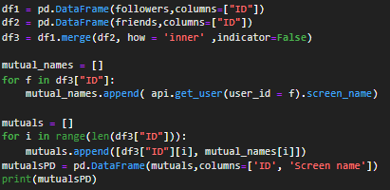
Methodology - User Mutuals
Used the merge method from panda to finds the common IDs between the user’s friends and followers list.
Used panda dataFrame to plots out all the mutuals.
Notes:
To find the mutuals between the 2 data collections, we simply used the panda merge method to find the common user ID and plot it out in a table using panda DataFrame.
Due to the small collection of 300 friends and followers each, occasionally we’d get no mutuals so we’d need to collect new data or choose a new user.

Slide 12
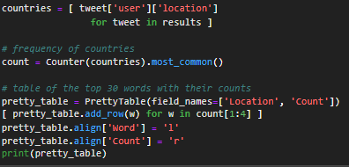
Methodology - Locations of interest
Similar methods with the word count analysis
Used Counter to finds the most common locations where the tweet users are.
Used PrettyTable to plot a table of the top 3 most popular locations.
Notes:
The process is similar to the word count analysis where we used counter and PrettyTable but on the location attribute instead.
There was a lot of trash data as a lot of users left their location empty and there’s no generalized way that they follow in setting their location so several resets were needed to get meaningful data.
Used PrettyTable to create a table of the top 3 most popular locations.

Slide 13

Result
Highest tweeting location was West Newbury, Massachusetts
Most frequently used words - Olympic, Winter, Figure and Skating
@Olympics is the user with the highest retweets
The most popular user mentions are @Beijing2022 and @Olympics
The most popular hashtags are #Beijing2022 and #BingDwenDwen
Designated Popular User: @rodmickleburgh

Slide 14
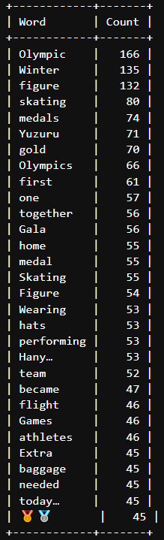
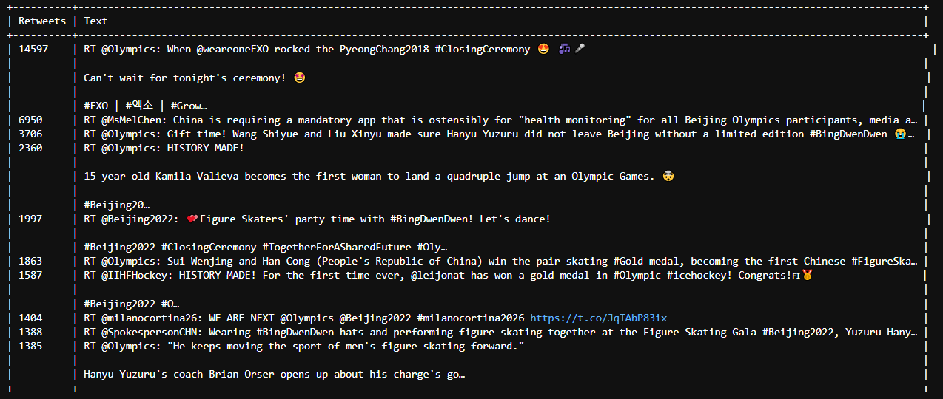
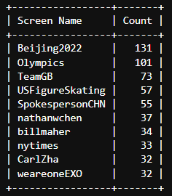
Results
Most frequently used words
Top 10 Most Popular Tweets by Retweets count Top 10 User Mentions

Slide 15
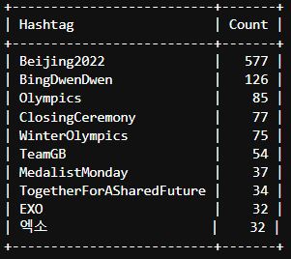
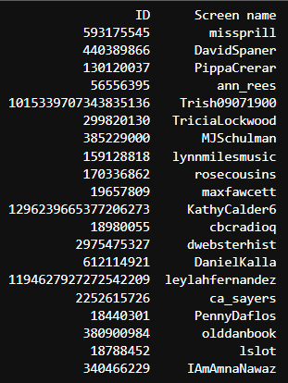
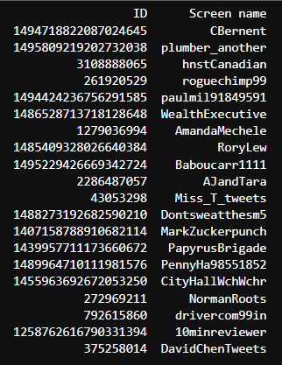
Results
Top 10 hashtags 20 of rodmickleburgh’s followers 20 of rodmickleburgh’s friends

Slide 16

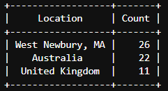
Results
@rodmickleburgh’s mutuals between friends and followers Top 3 most popular locations

Slide 17
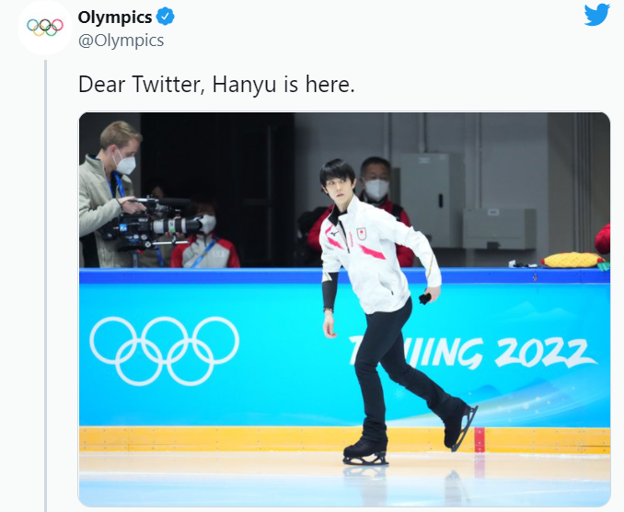
Conclusion-Sport
Yuzuru Hanyu，Figure skater，gold medalist.
Most popular athletes during the Olympic.

Slide 18

Conclusion-Ceremony
Closing ceremony is more concerned than the opening ceremony, because the date is closer to time of our last request.

Slide 19
Conclusion-User friends and followers
Although we have many friends and followers from the user, there are only one mutual user of friends and followers.
We conclude that there are not too much common friends and followers of a user in the topic of Winter Olympics.

Slide 20
Conclusion-Location
Twitter Data can give a more visual location of interest in the Winter Olympics. It will help the Olympic committee to find a good place for activities in the future.
Since the host of Winter Olympics, China banned twitter, and many countries do not speak English, The location can only give an elucidation of the English-speaking countries. And Since we are located in MA, we got more tweets from the state where we are located.
West Newbury, MA
Australia,
United Kingdom

